Slide 1
Detecting R&D Trends Using Administrative Data
2022 Spring NCSES – BI SDAD Seminar
3 May 2022

Slide 2
NCSES and UVA R&D Team
NCSES, Research & Development Statistics Program
John Jankowski, Senior Economic Advisor
Audrey Kindlon, Survey Statistician
University of Virginia, Biocomplexity Institute, Social and Decision Analytics
Kathryn Linehan, Research Scientist
Eric Oh, SDAD Research Assistant Professor, now a data scientist at Reify Health
Leonel Siwe, Postdoctoral Research Associate
Madeline Garrett, Student Intern
Joel Thurston, Senior Scientist
Stephanie Shipp, Deputy Division Director & Professor
Sallie Keller, Division Director and Distinguished Professor, Principal Investigator
1

Slide 3
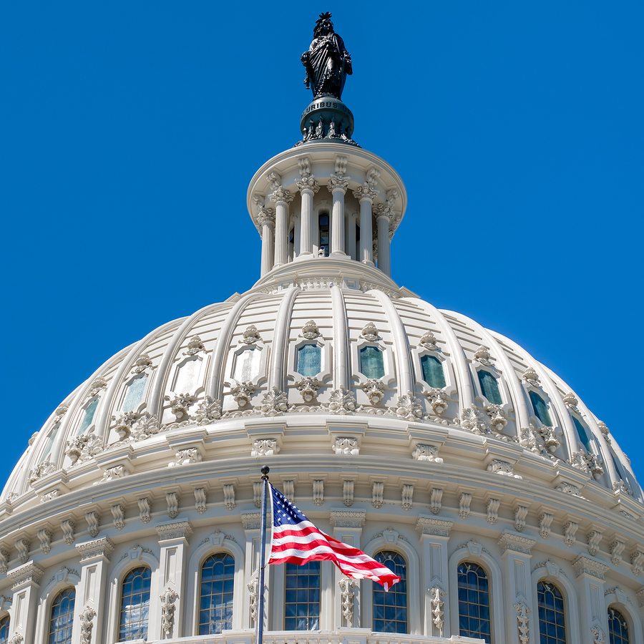

UVA Partnership with NCSES
NCSES and the Social and Decision Analytics Division at the Biocomplexity Institute have collaborated since 2016 to explore the feasibility of identifying and collecting data that naturally exists and repurposing those data to measure research, innovation, and related concepts.
Identify data and develop non-survey measurement tools and techniques
Train students and researchers with these tools and techniques
Use these tools to advance concepts of interest to policymakers
2

Slide 4
Impact of Work
The benefits and uses of this research include the ability to:
Identify directionality and impacts from public support for research and innovation
Inform R&D activities in current high priority areas with focus on resilience to shocks, e.g., pandemics
Discover data and develop new tools for STI policies
Tailor advice to policymakers about R&D funding priorities
Adapted from OECD. (2021). Working Party of National Experts on Science and Technology Indicators Establishment of an OECD Expert Group on the Management and Analysis of R&D and Innovation Administrative Data (MARIAD). Organization for Economic Development (OECD), Directorate for Science, Technology, and Innovation, Committee for Scientific and Technological Policy.
3
Notes:
John can do this slide at beginning
OECD. (2021). Working Party of National Experts on Science and Technology Indicators Establishment of an OECD Expert Group on the Management and Analysis of R&D and Innovation Administrative Data (MARIAD). Organization for Economic Development (OECD), Directorate for Science, Technology, and Innovation, Committee for Scientific and Technological Policy.

Slide 5
Motivating Questions
Can we use administrative data to supplement NCSES surveys to characterize federal funding for specific research topics (e.g., artificial intelligence, COVID-19)?
Around 21% of all research and development (R&D) funding in the United States is provided by the federal government¹
What specific research areas does this public funding support?
NCSES Federal Funds Survey and Federal Support Survey
Provides information on funding by agency and broad research fields
¹Table 3; Boroush M; National Center for Science and Engineering Statistics (NCSES). 2021. U.S. R&D Increased by $51 Billion in 2018, to $606 Billion; Estimate for 2019 Indicates a Further Rise to $656 Billion. NSF 21-324. Alexandria, VA: National Science Foundation. Available at https://ncses.nsf.gov/pubs/nsf21324/.
4

Slide 6
Detecting R&D Trends through
Static Topic Modeling

Slide 7

Data Source
Searchable database of scientific awards from federal agencies for FY 2008-2020
Raw number of projects: 1,262,655
After cleaning and processing: 1,143,869
Includes grant abstract text and other metadata
Allows researchers to link project information on:
The subject matter
The year it was funded
Which agency provided funding
5
Notes:
Retired on March 1, 2022 – next steps slide - how to replicate
-Focus now on topic funding trends (not emerging) so different dataset
Pulled from federal ExPORTER and search/export tool for NSF FY19-20
Number of Duplicates: 71,902

Slide 8
Data Cleaning
Removed projects without an abstract or those that were short phrases such as “No abstract provided”
Deduplicated projects based on fiscal year, title and abstract
Cleaned abstract text to prepare for topic modeling
Abstract
Final Tokens
Recent reports suggest an increasing frequency of severe outcomes of influenza virus infection when people also are infected with Staphylococcus aureus. This research will investigate whether synergistic effects occur as a result of being infected with both agents, as opposed to just influenza virus or Staphylococcus aureus, by using a swine model.
recent report suggest increase frequency severe outcome influenza virus infection people infect staphylococcus_aureus research investigate synergistic effect occur result infect agent oppose influenza virus staphylococcus_aureus swine model
6
Notes:
Pulled from federal ExPORTER and search/export tool for NSF FY19-20
Null abstract: 42,536
Number of Duplicates: 71,902
Cleaning text:
Removed phrases not relevant to the project such as “description (provided by applicant)”
Used natural language processing (NLP) steps
Tokenization, lemmatization, stop word removal, addition of bi- and tri-grams
Removed tokens of length 1 and numeric tokens that were not years

Slide 9
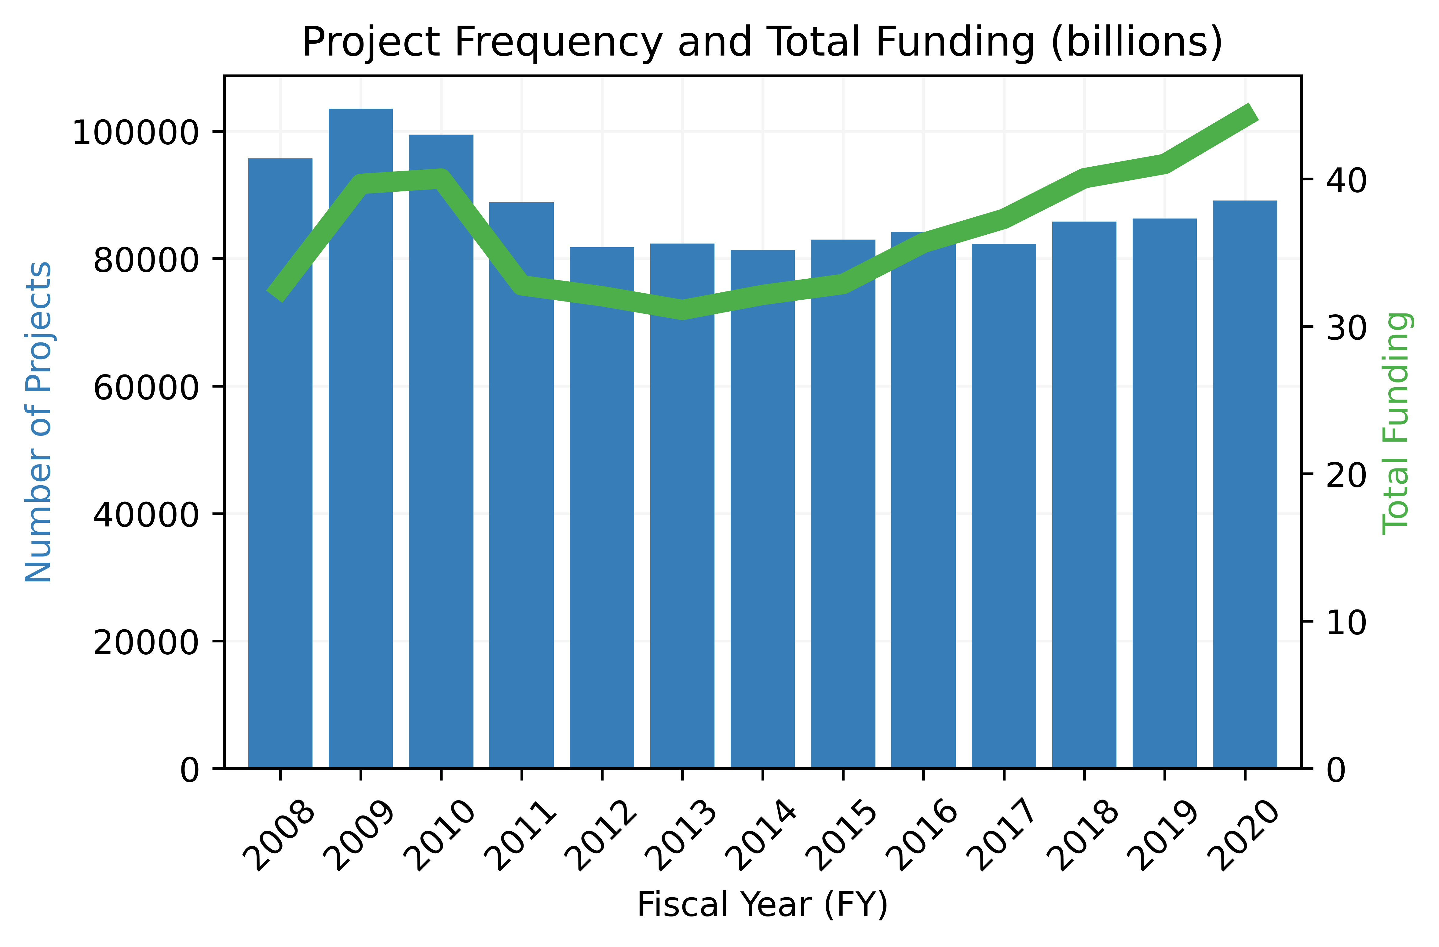
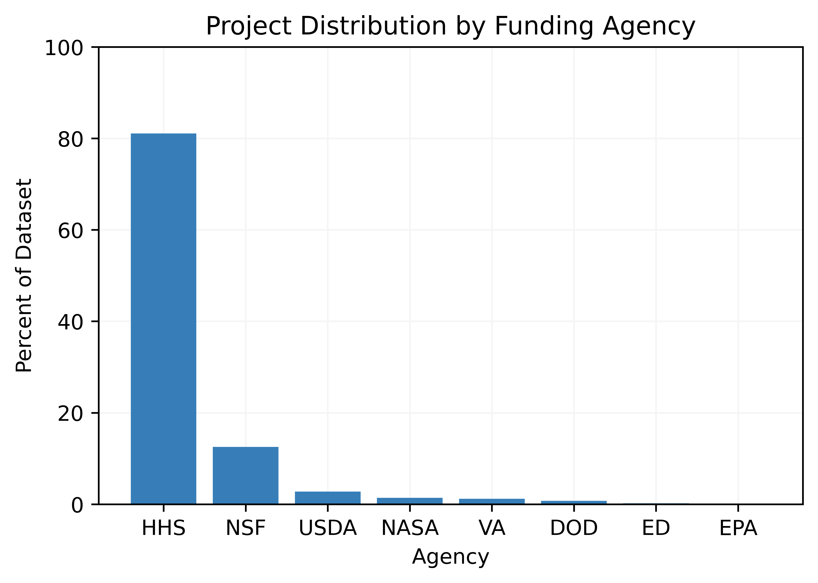
FY and Agency Distribution
Project Frequency and Total Funding (billions, U.S. dollars), 2008-2020
Project Distribution by Funding Agency, 2008-2020
HHS: $393 billion
NSF: $55.4 billion
HHS: U.S. Dept of Health and Human Services
NSF: National Science Foundation
Large increases in 2009-2010 due to American Recovery and Reinvestment Act of 2009 (ARRA)
Data Source: Federal RePORTER, FY 2008-2020. University of Virginia, Biocomplexity Institute, Social and Decision Analytics Division computations
7
Notes:
Difference of 118,786 projects from original data: 71,902 duplicates, 42,536 null abstracts, 4308 short abstracts, 40 other
You can derive this from left hand chart but could also say that the amount per project increased significantly in 2020.

Slide 10
Static Topic Modeling
Unsupervised machine learning technique for discovering latent topics in text data
A topic is a cluster of words that occur together frequently
Should capture a theme
Topic modeling results include the topics and a document-topic distribution that explains which documents contain which topics
Abstracts can contain more than one topic
cancer, tumor, breast, prostate, metastasis,
lung, metastatic, ovarian, target, therapy
8

Slide 11
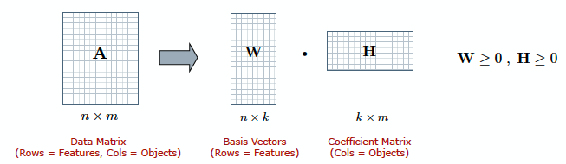
Non-negative Matrix Factorization (NMF)
Given a non-negative data matrix A, NMF finds a k-dimensional approximation in terms of non-negative factors W and H
k: number of topics (user-chosen parameter)
Document Term Matrix
(Rows = Abstracts, Cols = Terms)
Document Topic Distribution
(Rows = Abstracts, Cols = Topics)
Topic Term Distribution
(Rows = Topics, Cols = Terms)
9

Slide 12
Topic Modeling Results
List of topics for a 10-topic NMF model on Federal RePORTER abstracts
Topic 1 | Topic 2 | Topic 3 | Topic 4 | Topic 5
patient | core | brain | health | hiv
clinical | administrative | neuron | intervention | infection
trial | center | ad | child | vaccine
treatment | investigator | cognitive | risk | virus
disease | support | neural | care | aids
Topic 6 | Topic 7 | Topic 8 | Topic 9 | Topic 10
student | program | cancer | cell | protein
system | training | tumor | immune | gene
develop | student | breast | tumor | dna
datum | trainee | prostate | stem | genetic
method | faculty | metastasis | response | expression
10

Slide 13
Topic Trends
11
Notes:
In addition to finding topics in a text corpus, we can also track topic trends
Trend line is found using regression on fiscal year and mean topic weight

Slide 14
Themed R&D Trends: Case Studies

Slide 15
Research Questions
Can we use administrative data to obtain more granular information around a particular theme (e.g., artificial intelligence, pandemics) in order to supplement NCSES surveys?
Instead of giving a broad R&D characterization, can we use the same administrative dataset (Federal RePORTER) to provide an R&D characterization around a particular theme?
Two case studies:
Artificial Intelligence (AI)
Pandemics
12
Notes:
- New results – 2020 data, deduplication process has changed, adding funding info
- Extension of previous results

Slide 16
Themed Topic Modeling
Methods:
Information Retrieval – filter corpus to identify theme-related projects
Term matching: identify abstracts that contain keywords
Latent semantic indexing (LSI): dimensionality reduction technique that identifies abstracts related to the keywords
It is not necessary for the abstracts to contain the keywords
BERT: method using mathematical representations for words that convey semantic information
Bidirectional Encoder Representations from Transformers
Abstracts checked for similarity to keywords
NMF Topic Modeling on themed corpus abstracts
13
Notes:
BERT: Bidirectional Encoder Representations from Transformers

Slide 17
AI Information Retrieval
To create the AI corpus:
Construct sentence embeddings for each sentence in every abstract using BERT
Construct sentence embeddings for each sentence in the Artificial Intelligence Wikipedia page using BERT
Calculate the cosine similarity for each pairwise combination of sentence embeddings
Take the mean of the top 10 scores for each sentence in an abstract: average the scores across sentences to obtain the similarity score for an abstract
Use a cutoff of 2.5 SDs above the mean abstract similarity score to classify as AI
14
Notes:
BERT: Bidirectional Encoder Representations from Transformers

Slide 18
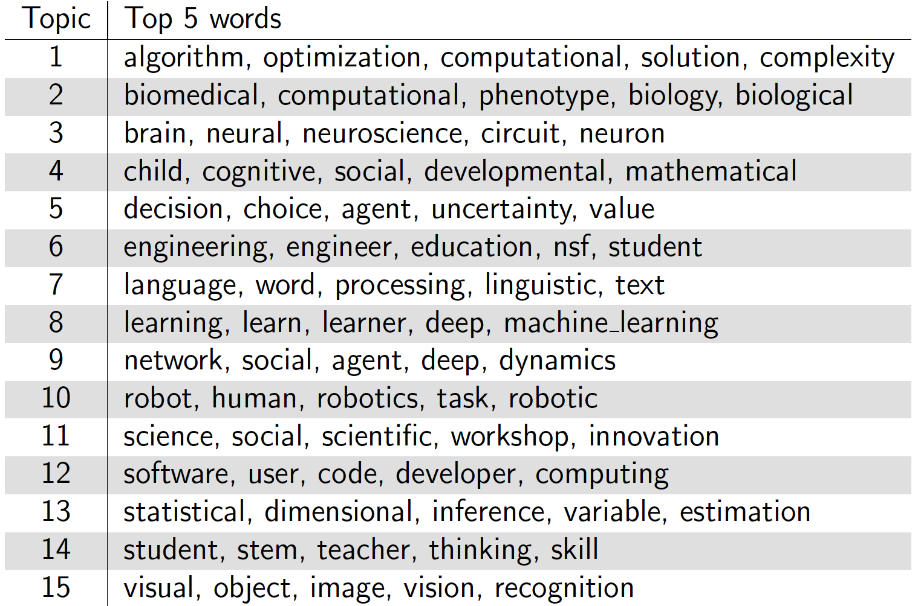
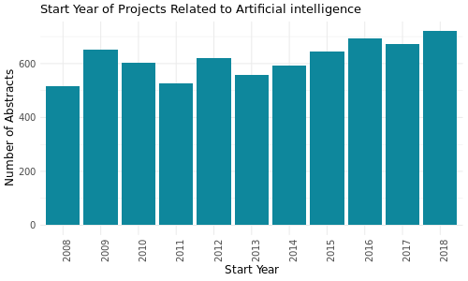
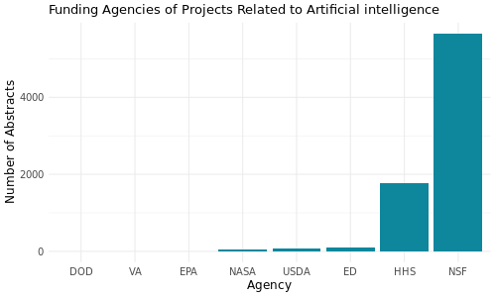
Artificial Intelligence Case Study
AI Corpus: 7,658 abstracts
15
Notes:
BERT IR method
k: variety of choices in this talk
Axis on right that shows total dollars in billions
Comparison with pandemics topics and dollar amounts
Early work on AI
Mention method used for each case study. Two sentence summary of BERT

Slide 19
Pandemics Information Retrieval
To create the Pandemics corpus:
Include an abstract if it contains the term ‘pandemic’
Use LSI to score each abstract as relevant to a pandemics query
A score is in [-1, 1] with scores closer to 1 signifying higher similarity to the query
Include an abstract if it scores 0.7 or above
16
Notes:
Pandemics query – all tokens that include “pandemic”
- Includes bigrams, trigrams, and misspellings

Slide 20
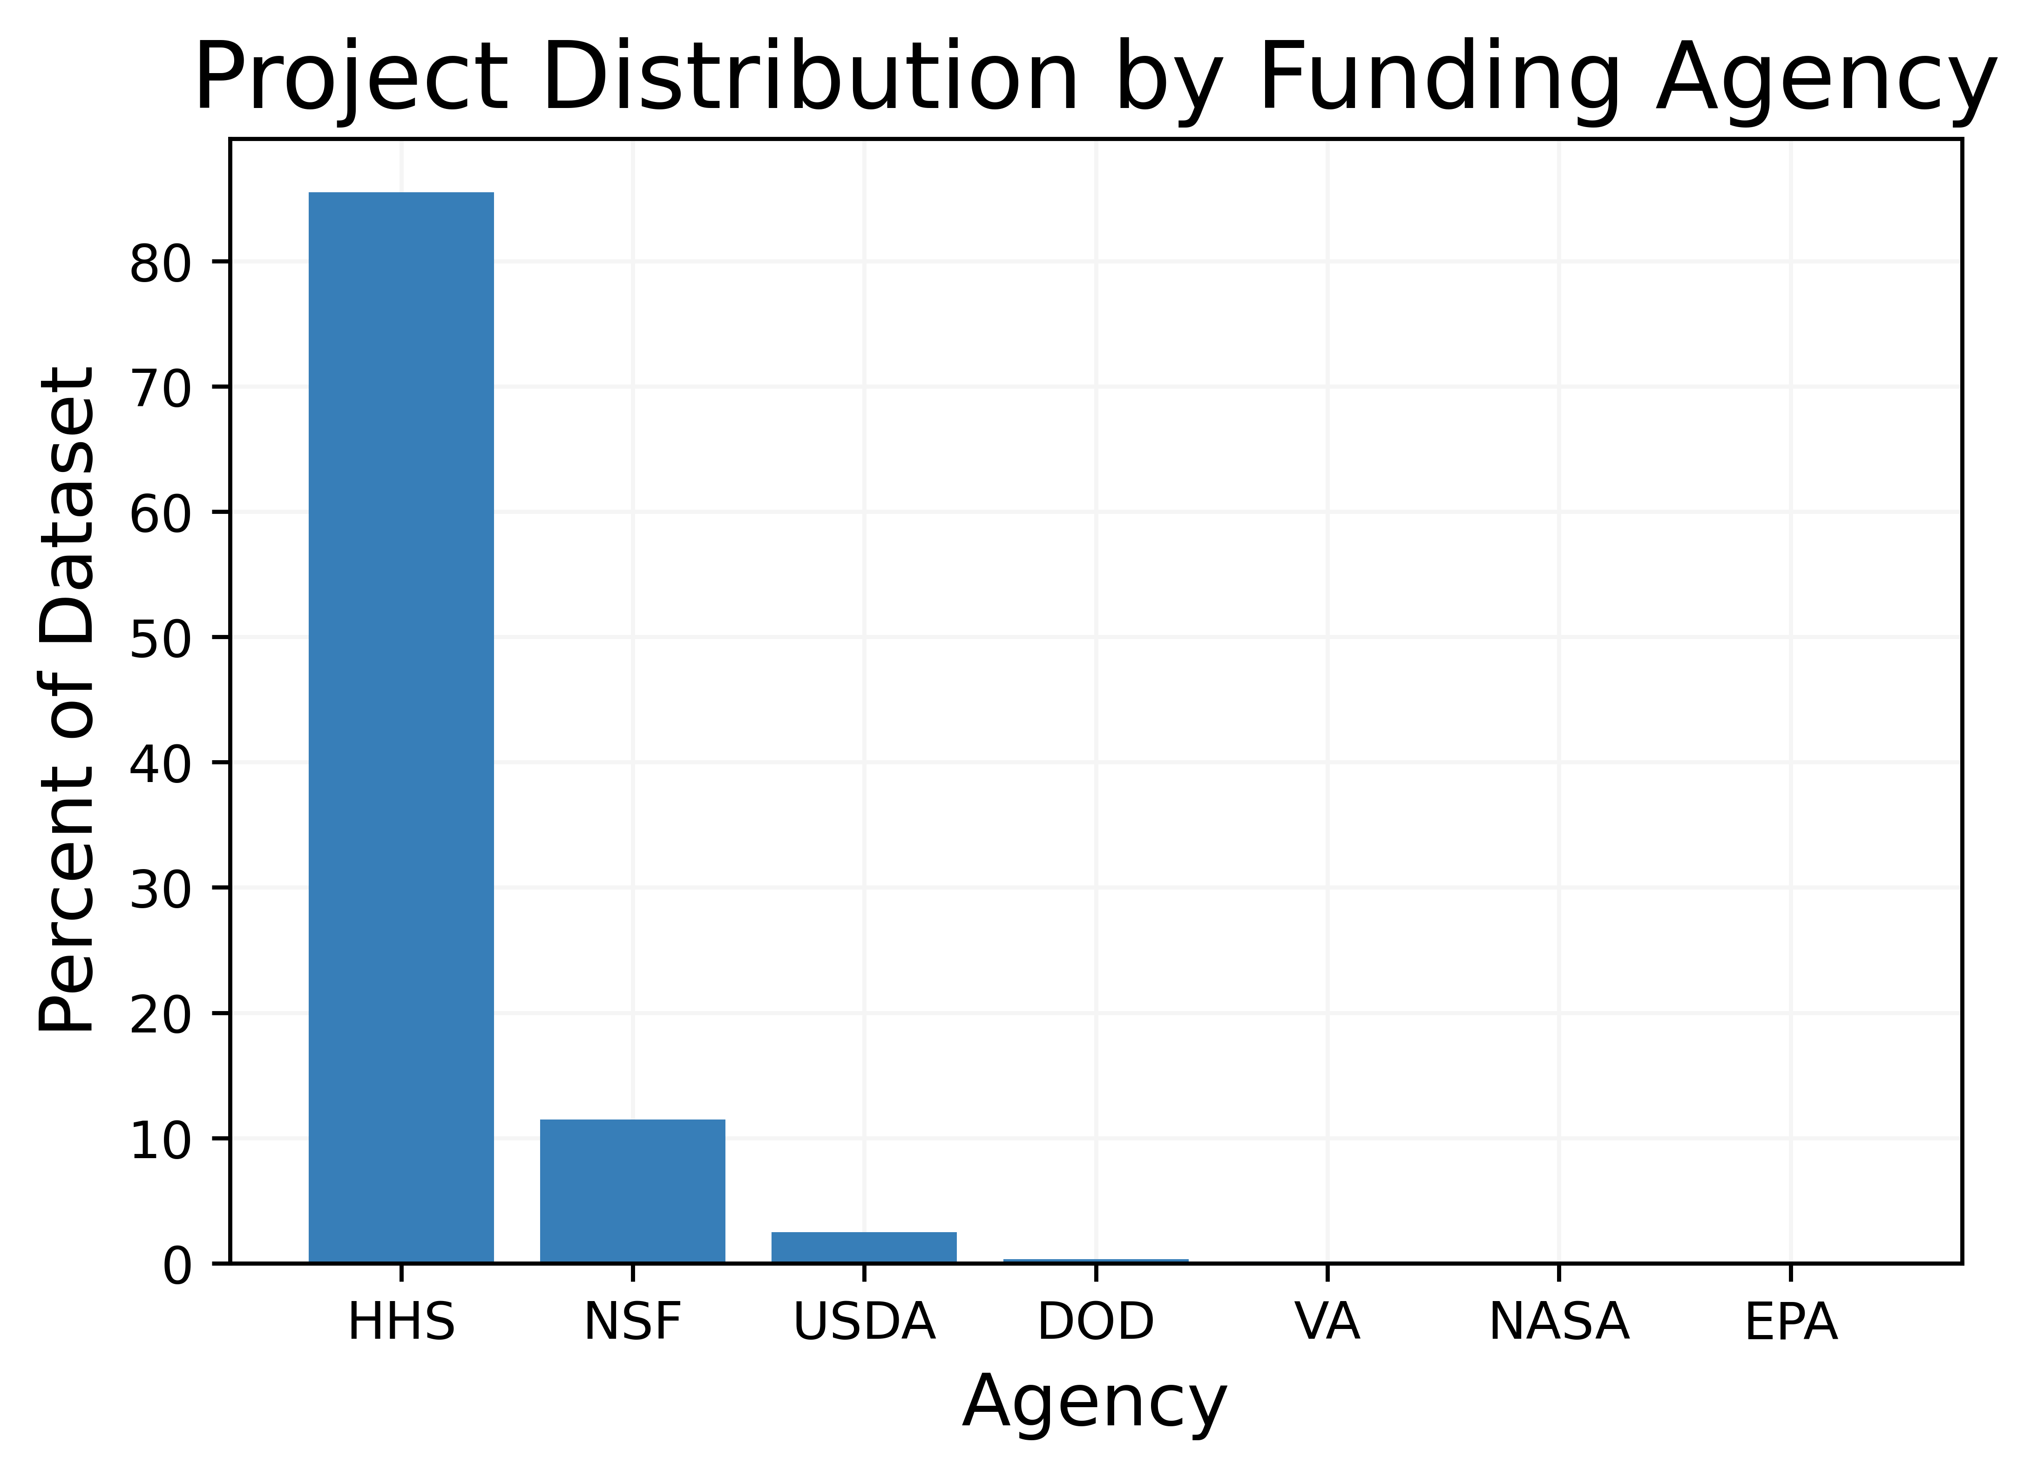
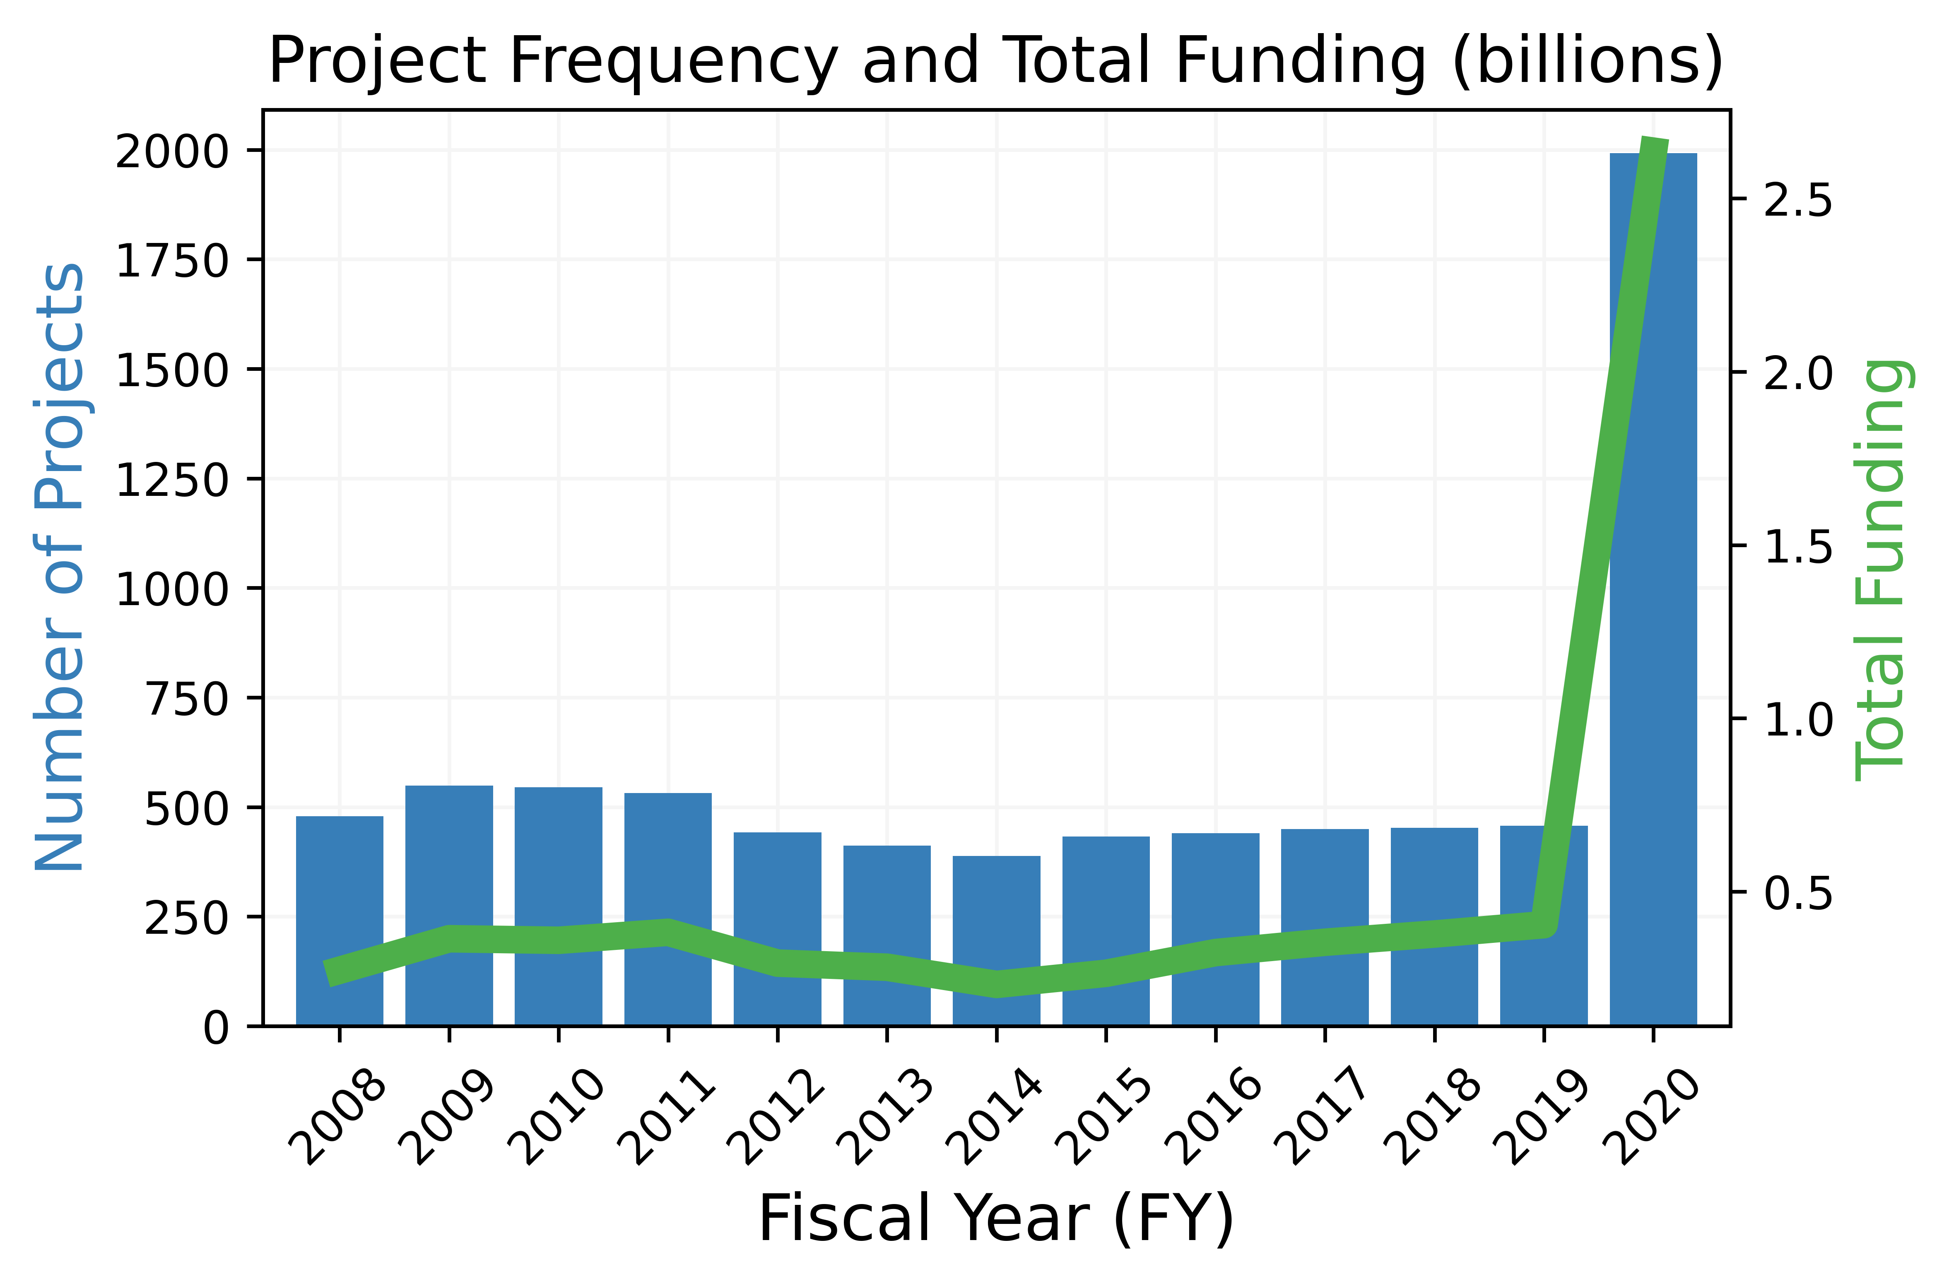
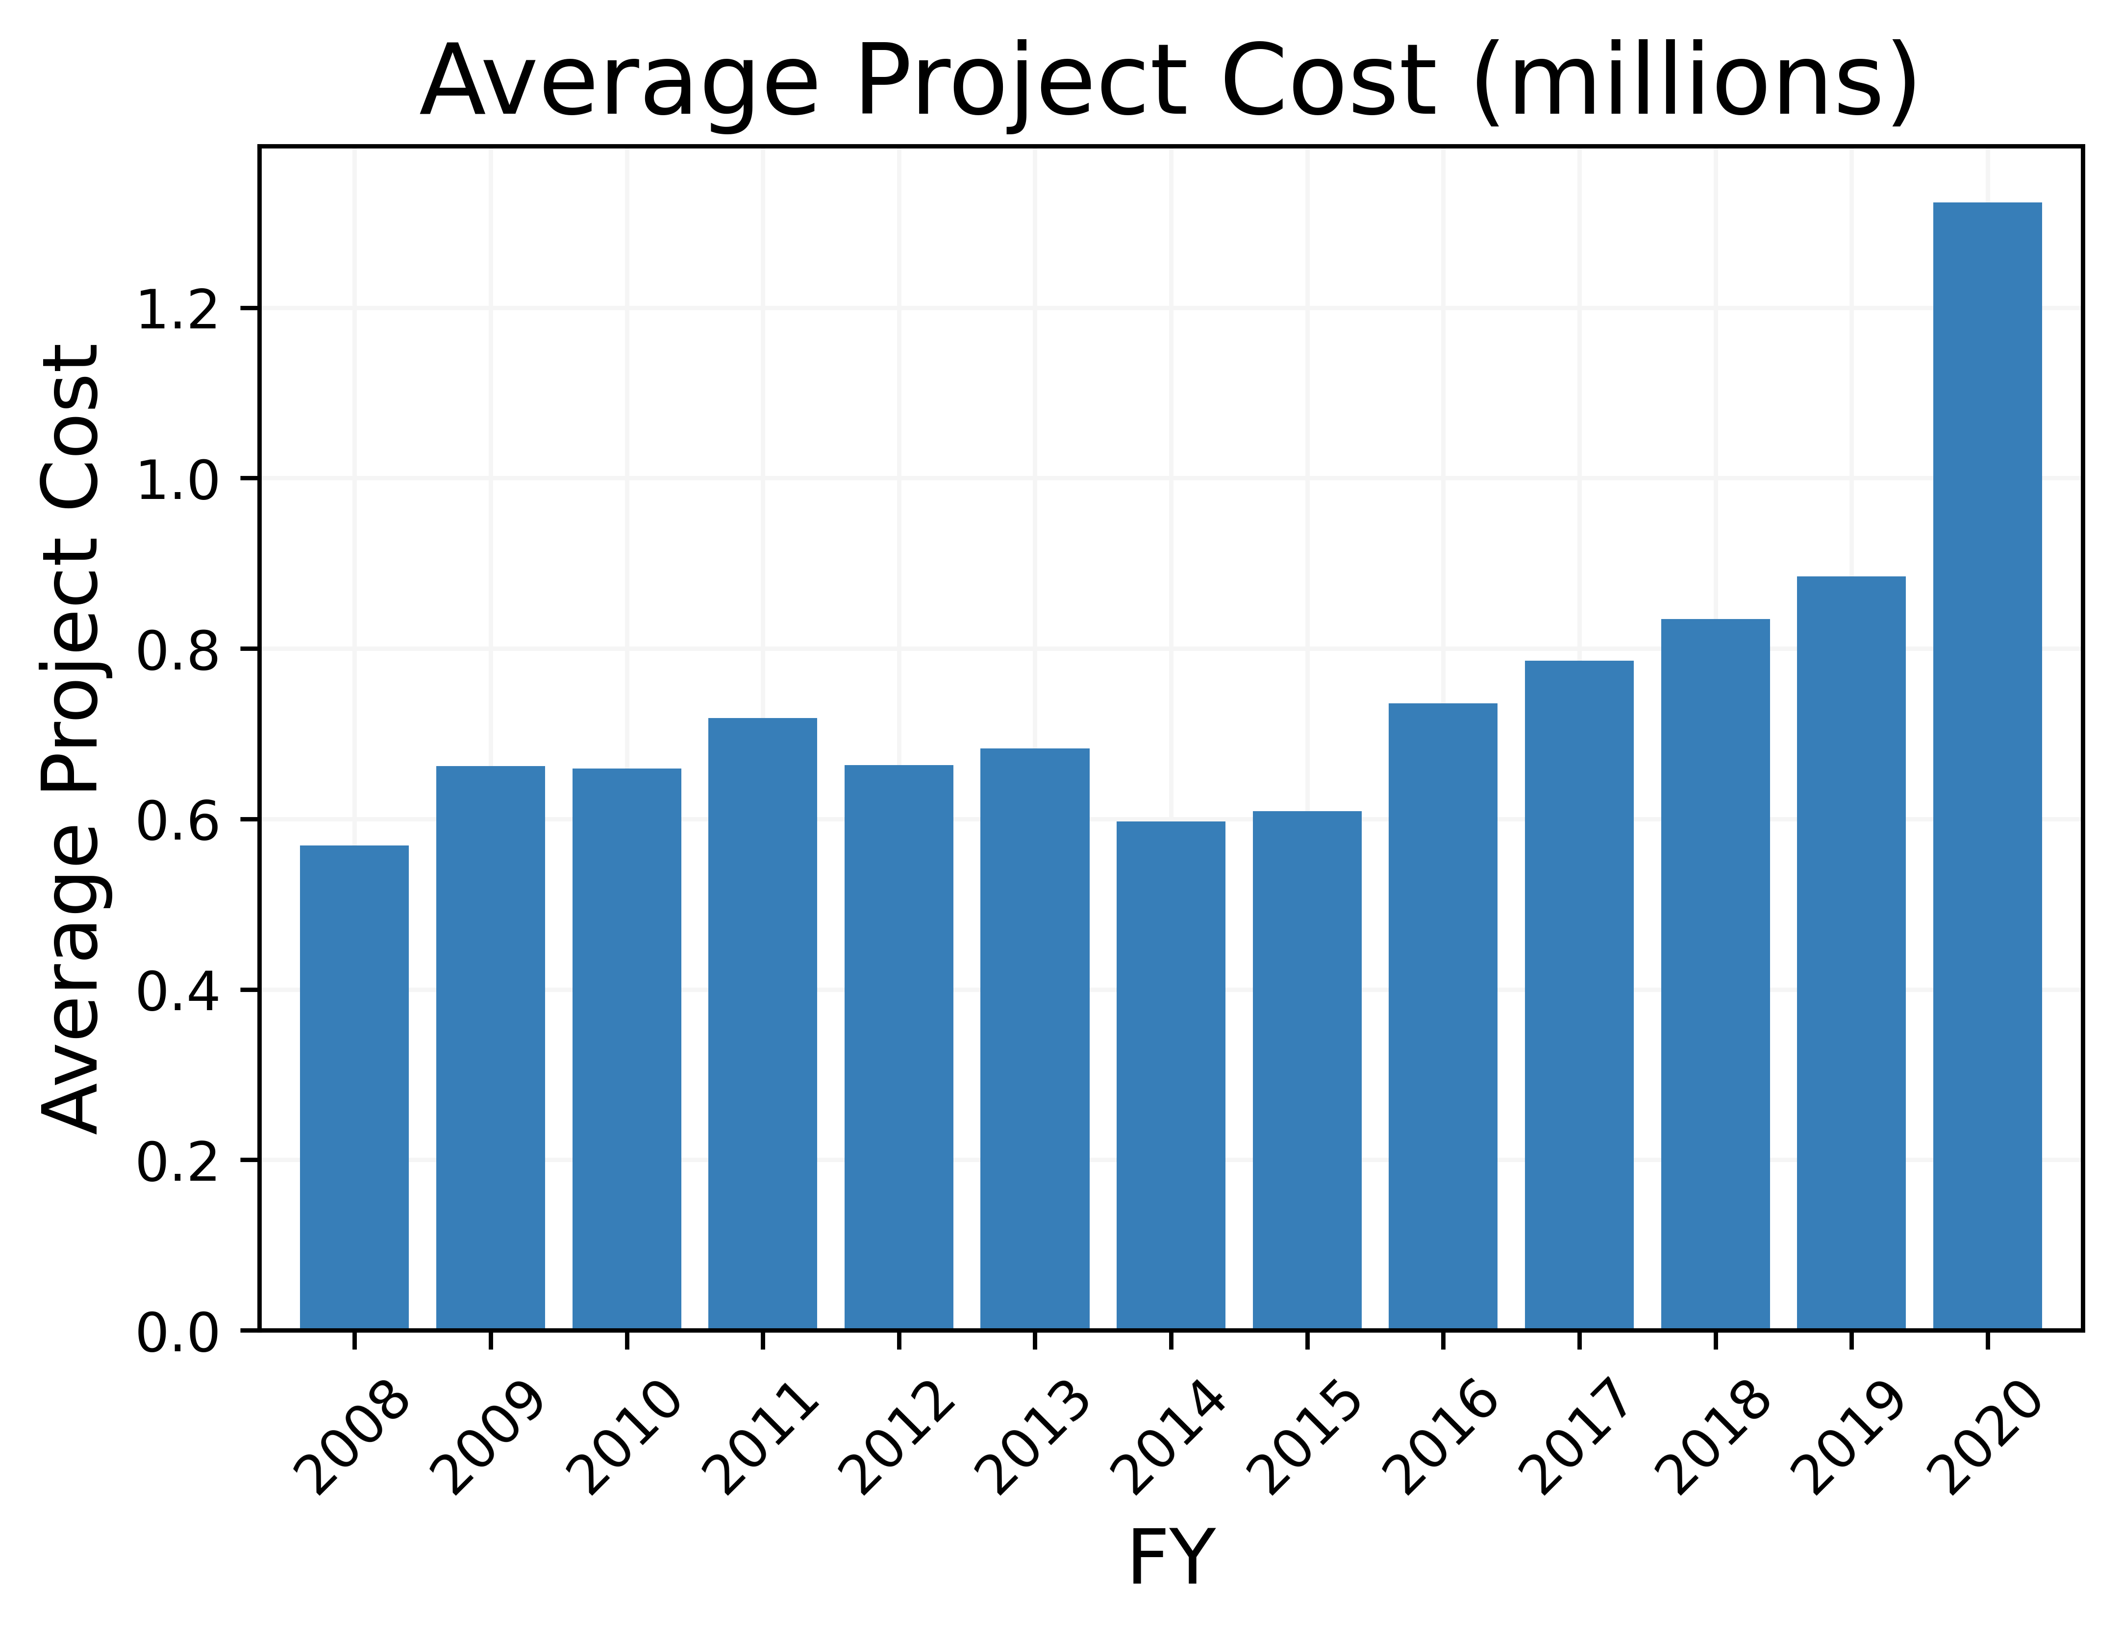
Pandemics Case Study
Project Distribution by Funding Agency, 2008-2020
HHS: $6.1 billion
Pandemics Corpus: 7,571 abstracts
Project Frequency and Total Funding (billions, U.S. dollars)
NSF: $0.3 billion
Average Project Cost (millions, U.S. dollars)
17
Notes:
- Includes any abstract containing the word “pandemic” and abstracts relevant to pandemics as scored by LSI
-number of projects go up by a factor of 4, budget by a factor of 5.

Slide 21
Pandemics Case Study
Topic Trends and Funding (billions, U.S. dollars)
18
Notes:
-coronavirus topic – most recently dominated by focus on covid-19
- use as a learning exercise – many topics with same word "virus", topic identification selection, covid-19 may not be a word in the early projects, but the projects are still in the topic
-try to have a reasonable explanation for hiv (vaccine breakthrough), and covid-19 topic funding in 2008-2012 for possible questions

Slide 22
Detecting R&D Trends through
Dynamic Topic Models

Slide 23
Research Questions
While we have just measured topic prevalence over time using static topic models, how can we measure changes in topic content over time?
Content of research topics changes over time as new ideas and technologies arise. The language describing these topics may change as well.
Do the top terms of a topic change over time?
Do topics appear and/or disappear over time?
Can we use administrative data to discover R&D trends other than those discovered using static topic models?
Static topic models do not account for changes in topic composition across time.
But dynamic topic models do!
19
Notes:
BERT: Bidirectional Encoder Representations from Transformers
Looking at trends in a different way between static and dynamic models (can verbalize as well), incorporates time in a different way

Slide 24
Dynamic Topic Models
Exploratory work
Model: Dynamic Nonnegative Matrix Factorization (Dynamic NMF)¹
Difference from Static NMF
Words defining a topic can change with time
A document at time t is correlated with documents at time t-1
¹Greene, D., & Cross, J. P. (2017). Exploring the political agenda of the European parliament using a dynamic topic modeling approach. Political Analysis, 25(1), 77-94.
Graphic Source:​ Y. Chen, H. Zhang, J. Wu, X. Wang, R. Liu and M. Lin, "Modeling Emerging, Evolving and Fading Topics Using Dynamic Soft Orthogonal NMF with Sparse Representation," 2015 IEEE International Conference on Data Mining, 2015, pp. 61-70, doi: 10.1109/ICDM.2015.96.
20
Notes:
- The difference from the static model rely on one assumption. From the static model, words and documents are exchangeable meaning that there is no order among documents and words.
But for the dynamic topic model, documents at a time t are build on document at t-1 as shown in the figure. This documents ordering allows us to capture change in words defining a topic in a correlated set of documents.

Slide 25
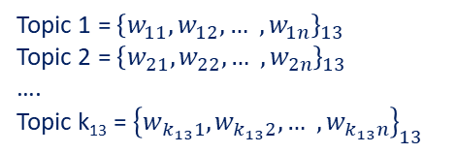
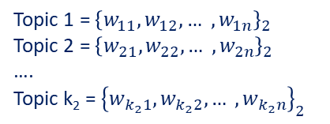

Dynamic NMF Model
FY 2008
FY 2009
FY 2020
Step 1:
Run a static NMF model on abstracts from each fiscal year
Potential for different number of topics in each model
Topic 1 = ${\left\{w_{11}, w_{12}, … ,w_{1n}\right\}}_{1}$
Topic 2 = ${\left\{w_{21}, w_{22}, … ,w_{2n}\right\}}_{1}$
….
Topic k₁ = ${\left\{w_{k_{1}1}, w_{k_{1}2}, … ,w_{k_{1}n}\right\}}_{1}$
Topic 1 = ${\left\{w_{11}, w_{12}, … ,w_{1n}\right\}}_{2}$
Topic 2 = ${\left\{w_{21}, w_{22}, … ,w_{2n}\right\}}_{2}$
….
Topic k₂ = ${\left\{w_{k_{2}1}, w_{k_{2}2}, … ,w_{k_{2}n}\right\}}_{2}$
…
Topic 1 = ${\left\{w_{11}, w_{12}, … ,w_{1n}\right\}}_{13}$
Topic 2 = ${\left\{w_{21}, w_{22}, … ,w_{2n}\right\}}_{13}$
….
Topic k₁₃ = ${\left\{w_{k_{13}1}, w_{k_{13}2}, … ,w_{k_{13}n}\right\}}_{13}$
Step 2: Clustering to k topics
Combine all topics from the first step as a new document term matrix
Run a static NMF model on the new document term matrix
21
Notes:
The second step cluster all the topics from the first stage into k general topics.
Topics from different fiscal year in the same cluster, capture how the general topic associated with the cluster changed over time.

Slide 26
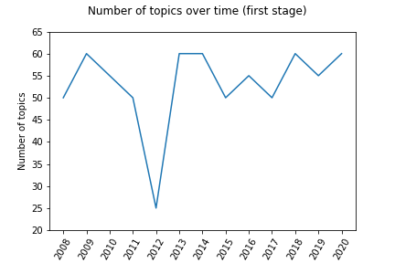
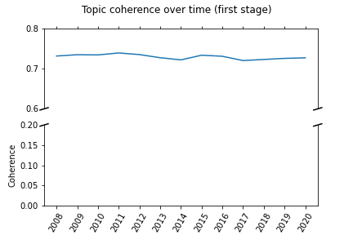
Dynamic NMF Tuning Results from Step 1
Difference in the number of topics at each fiscal year.
The best model score (topic coherence) is the same over the fiscal year.
Number of topics range (minimum=20 ; maximum=60)

Slide 27
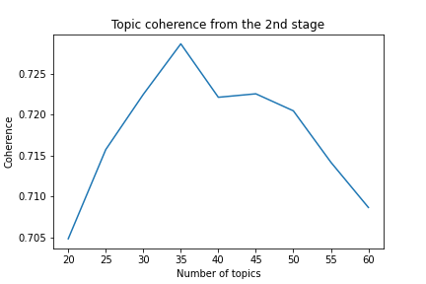
Number of Topics
Number of topics in the model is a user-chosen parameter (similar to static NMF)
We use topic coherence, a measure of performance for the model, to inform the choice for number of topics
The optimal number of topics for the model is 35.
22
Notes:
- The key parameter to tune is the number of topics for each fiscal year in the first stage and the number of topic at the second stage. Those number of topics are independent.
- The figure show the topic coherence for a range value of number of topic during the second stage.

Slide 28
Dynamic NMF Results
Topic 1 | cell | type | differentiation | cd4 | cellular | stem | antigen | tissue | epithelial | culture
Topic 2 | mouse | model | human | animal | transgenic | mutation | vivo | mutant | disease | study
Topic 3 | child | parent | family | language | pediatric | childhood | early | infant | school | asd
Topic 4 | patient | treatment | therapy | outcome | disease | improve | biomarker | treat | symptom | study
Topic 5 | hiv | aids | infect | infection | prevention | antiretroviral | transmission | art | cfar | msm
Topic 6 | protein | membrane | structure | bind | complex | interaction | function | structural | domain | rna
Topic 7 | signal | pathway | regulate | mechanism | activation | role | regulation | kinase | growth | receptor
Topic 8 | health | community | disparity | public | population | policy | minority | mental | environmental | partnership
Topic 9 | drug | compound | resistance | target | inhibitor | cocaine | abuse | treatment | therapeutic | addiction
Topic 10 | tumor | metastasis | therapy | metastatic | anti | melanoma | microenvironment | gbm | growth | glioma
Topic 11 | cancer | prostate | nci | pancreatic | ovarian | member | colorectal | oncology | prevention | colon
Topic 12 | clinical | trial | translational | protocol | phase | study | conduct | center | support | investigator
Topic 13 | immune | response | innate | inflammatory | antigen | immunity | cytokine | inflammation | infection | dc
Topic 14 | student | graduate | undergraduate | science | program | school | college | education | engineering | teacher
Topic 15 | gene | expression | genetic | transcription | chromatin | regulatory | regulation | identify | transcriptional | epigenetic
Topic 16 | brain | injury | neural | tbi | disorder | cognitive | connectivity | functional | fmri | stroke
Topic 17 | dna | repair | damage | replication | genome | methylation | chromatin | sequence | epigenetic | dsb
Topic 18 | lung | pulmonary | airway | asthma | injury | copd | alveolar | epithelial | cf | inflammation
Topic 19 | insulin | obesity | metabolic | glucose | diabetes | diabete | weight | metabolism | resistance | diet
Topic 20 | ad | alzheimer | tau | disease | amyloid | dementia | pathology | cognitive | aŒ≤ | biomarker
Topic 21 | vaccine | antibody | antigen | vaccination | influenza | protection | response | immunity | epitope | protective
Topic 22 | imaging | image | mri | resolution | tissue | technique | pet | optical | method | microscopy
Topic 23 | core | investigator | center | support | service | administrative | provide | facility | resource | program
Topic 24 | datum | analysis | data | statistical | method | tool | software | database | computational | develop
Topic 25 | neuron | synaptic | circuit | neuronal | motor | neural | sensory | plasticity | visual | cortical
Topic 26 | virus | infection | viral | host | hiv_1 | replication | pathogen | influenza | bacterial | rna
Topic 27 | care | provider | quality | health | service | hospital | outcome | cost | practice | implementation
Topic 28 | training | program | trainee | faculty | mentor | career | year | scientist | train | biology
Topic 29 | risk | factor | study | exposure | cohort | woman | cvd | genetic | high | environmental
Topic 30 | alcohol | ethanol | drinking | use | consumption | abuse | dependence | alcoholism | aud | drink
Topic 31 | disease | kidney | heart | cardiac | renal | ckd | failure | cardiovascular | genetic | vascular
Topic 32 | cognitive | age | memory | aging | old | adult | decline | task | change | impairment
Topic 33 | intervention | behavior | treatment | month | control | self | youth | adolescent | outcome | adherence
Topic 34 | breast | woman | cancer | metastasis | estrogen | er | mammary | her2 | tnbc | mammography
Topic 35 | bone | fracture | osteoporosis | osteoblast | skeletal | tissue | formation | loss | osteoclast | muscle
23
Notes:
- table presents the top 10 words that define each of those 35 topics.
- Just like the static topic, we bring expertise to define those topics and if we zoom in some topics

Slide 29
Dynamic NMF Results
Topic 1 | cell | type | differentiation | cd4 | cellular | stem | antigen | tissue | epithelial | culture
Topic 2 | mouse | model | human | animal | transgenic | mutation | vivo | mutant | disease | study
Topic 3 | child | parent | family | language | pediatric | childhood | early | infant | school | asd
Topic 4 | patient | treatment | therapy | outcome | disease | improve | biomarker | treat | symptom | study
Topic 5 | hiv | aids | infect | infection | prevention | antiretroviral | transmission | art | cfar | msm
Topic 6 | protein | membrane | structure | bind | complex | interaction | function | structural | domain | rna
Topic 7 | signal | pathway | regulate | mechanism | activation | role | regulation | kinase | growth | receptor
Topic 8 | health | community | disparity | public | population | policy | minority | mental | environmental | partnership
Topic 9 | drug | compound | resistance | target | inhibitor | cocaine | abuse | treatment | therapeutic | addiction
Topic 10 | tumor | metastasis | therapy | metastatic | anti | melanoma | microenvironment | gbm | growth | glioma
Topic 11 | cancer | prostate | nci | pancreatic | ovarian | member | colorectal | oncology | prevention | colon
Topic 12 | clinical | trial | translational | protocol | phase | study | conduct | center | support | investigator
Topic 13 | immune | response | innate | inflammatory | antigen | immunity | cytokine | inflammation | infection | dc
Topic 14 | student | graduate | undergraduate | science | program | school | college | education | engineering | teacher
Topic 15 | gene | expression | genetic | transcription | chromatin | regulatory | regulation | identify | transcriptional | epigenetic
Topic 16 | brain | injury | neural | tbi | disorder | cognitive | connectivity | functional | fmri | stroke
Topic 17 | dna | repair | damage | replication | genome | methylation | chromatin | sequence | epigenetic | dsb
Topic 18 | lung | pulmonary | airway | asthma | injury | copd | alveolar | epithelial | cf | inflammation
Topic 19 | insulin | obesity | metabolic | glucose | diabetes | diabete | weight | metabolism | resistance | diet
Topic 20 | ad | alzheimer | tau | disease | amyloid | dementia | pathology | cognitive | aŒ≤ | biomarker
Topic 21 | vaccine | antibody | antigen | vaccination | influenza | protection | response | immunity | epitope | protective
Topic 22 | imaging | image | mri | resolution | tissue | technique | pet | optical | method | microscopy
Topic 23 | core | investigator | center | support | service | administrative | provide | facility | resource | program
Topic 24 | datum | analysis | data | statistical | method | tool | software | database | computational | develop
Topic 25 | neuron | synaptic | circuit | neuronal | motor | neural | sensory | plasticity | visual | cortical
Topic 26 | virus | infection | viral | host | hiv_1 | replication | pathogen | influenza | bacterial | rna
Topic 27 | care | provider | quality | health | service | hospital | outcome | cost | practice | implementation
Topic 28 | training | program | trainee | faculty | mentor | career | year | scientist | train | biology
Topic 29 | risk | factor | study | exposure | cohort | woman | cvd | genetic | high | environmental
Topic 30 | alcohol | ethanol | drinking | use | consumption | abuse | dependence | alcoholism | aud | drink
Topic 31 | disease | kidney | heart | cardiac | renal | ckd | failure | cardiovascular | genetic | vascular
Topic 32 | cognitive | age | memory | aging | old | adult | decline | task | change | impairment
Topic 33 | intervention | behavior | treatment | month | control | self | youth | adolescent | outcome | adherence
Topic 34 | breast | woman | cancer | metastasis | estrogen | er | mammary | her2 | tnbc | mammography
Topic 35 | bone | fracture | osteoporosis | osteoblast | skeletal | tissue | formation | loss | osteoclast | muscle
Topic 1
cell
type
differentiation
cd4
cellular
stem
antigen
tissue
epithelial
culture
24

Slide 30
Dynamic NMF Results
Topic 1 | cell | type | differentiation | cd4 | cellular | stem | antigen | tissue | epithelial | culture
Topic 2 | mouse | model | human | animal | transgenic | mutation | vivo | mutant | disease | study
Topic 3 | child | parent | family | language | pediatric | childhood | early | infant | school | asd
Topic 4 | patient | treatment | therapy | outcome | disease | improve | biomarker | treat | symptom | study
Topic 5 | hiv | aids | infect | infection | prevention | antiretroviral | transmission | art | cfar | msm
Topic 6 | protein | membrane | structure | bind | complex | interaction | function | structural | domain | rna
Topic 7 | signal | pathway | regulate | mechanism | activation | role | regulation | kinase | growth | receptor
Topic 8 | health | community | disparity | public | population | policy | minority | mental | environmental | partnership
Topic 9 | drug | compound | resistance | target | inhibitor | cocaine | abuse | treatment | therapeutic | addiction
Topic 10 | tumor | metastasis | therapy | metastatic | anti | melanoma | microenvironment | gbm | growth | glioma
Topic 11 | cancer | prostate | nci | pancreatic | ovarian | member | colorectal | oncology | prevention | colon
Topic 12 | clinical | trial | translational | protocol | phase | study | conduct | center | support | investigator
Topic 13 | immune | response | innate | inflammatory | antigen | immunity | cytokine | inflammation | infection | dc
Topic 14 | student | graduate | undergraduate | science | program | school | college | education | engineering | teacher
Topic 15 | gene | expression | genetic | transcription | chromatin | regulatory | regulation | identify | transcriptional | epigenetic
Topic 16 | brain | injury | neural | tbi | disorder | cognitive | connectivity | functional | fmri | stroke
Topic 17 | dna | repair | damage | replication | genome | methylation | chromatin | sequence | epigenetic | dsb
Topic 18 | lung | pulmonary | airway | asthma | injury | copd | alveolar | epithelial | cf | inflammation
Topic 19 | insulin | obesity | metabolic | glucose | diabetes | diabete | weight | metabolism | resistance | diet
Topic 20 | ad | alzheimer | tau | disease | amyloid | dementia | pathology | cognitive | aŒ≤ | biomarker
Topic 21 | vaccine | antibody | antigen | vaccination | influenza | protection | response | immunity | epitope | protective
Topic 22 | imaging | image | mri | resolution | tissue | technique | pet | optical | method | microscopy
Topic 23 | core | investigator | center | support | service | administrative | provide | facility | resource | program
Topic 24 | datum | analysis | data | statistical | method | tool | software | database | computational | develop
Topic 25 | neuron | synaptic | circuit | neuronal | motor | neural | sensory | plasticity | visual | cortical
Topic 26 | virus | infection | viral | host | hiv_1 | replication | pathogen | influenza | bacterial | rna
Topic 27 | care | provider | quality | health | service | hospital | outcome | cost | practice | implementation
Topic 28 | training | program | trainee | faculty | mentor | career | year | scientist | train | biology
Topic 29 | risk | factor | study | exposure | cohort | woman | cvd | genetic | high | environmental
Topic 30 | alcohol | ethanol | drinking | use | consumption | abuse | dependence | alcoholism | aud | drink
Topic 31 | disease | kidney | heart | cardiac | renal | ckd | failure | cardiovascular | genetic | vascular
Topic 32 | cognitive | age | memory | aging | old | adult | decline | task | change | impairment
Topic 33 | intervention | behavior | treatment | month | control | self | youth | adolescent | outcome | adherence
Topic 34 | breast | woman | cancer | metastasis | estrogen | er | mammary | her2 | tnbc | mammography
Topic 35 | bone | fracture | osteoporosis | osteoblast | skeletal | tissue | formation | loss | osteoclast | muscle
Topic 5
hiv
aids
infect
infection
prevention
antiretrovial
transmission
art
cfar
msm
25

Slide 31
Dynamic NMF Results
Topic 1 | cell | type | differentiation | cd4 | cellular | stem | antigen | tissue | epithelial | culture
Topic 2 | mouse | model | human | animal | transgenic | mutation | vivo | mutant | disease | study
Topic 3 | child | parent | family | language | pediatric | childhood | early | infant | school | asd
Topic 4 | patient | treatment | therapy | outcome | disease | improve | biomarker | treat | symptom | study
Topic 5 | hiv | aids | infect | infection | prevention | antiretroviral | transmission | art | cfar | msm
Topic 6 | protein | membrane | structure | bind | complex | interaction | function | structural | domain | rna
Topic 7 | signal | pathway | regulate | mechanism | activation | role | regulation | kinase | growth | receptor
Topic 8 | health | community | disparity | public | population | policy | minority | mental | environmental | partnership
Topic 9 | drug | compound | resistance | target | inhibitor | cocaine | abuse | treatment | therapeutic | addiction
Topic 10 | tumor | metastasis | therapy | metastatic | anti | melanoma | microenvironment | gbm | growth | glioma
Topic 11 | cancer | prostate | nci | pancreatic | ovarian | member | colorectal | oncology | prevention | colon
Topic 12 | clinical | trial | translational | protocol | phase | study | conduct | center | support | investigator
Topic 13 | immune | response | innate | inflammatory | antigen | immunity | cytokine | inflammation | infection | dc
Topic 14 | student | graduate | undergraduate | science | program | school | college | education | engineering | teacher
Topic 15 | gene | expression | genetic | transcription | chromatin | regulatory | regulation | identify | transcriptional | epigenetic
Topic 16 | brain | injury | neural | tbi | disorder | cognitive | connectivity | functional | fmri | stroke
Topic 17 | dna | repair | damage | replication | genome | methylation | chromatin | sequence | epigenetic | dsb
Topic 18 | lung | pulmonary | airway | asthma | injury | copd | alveolar | epithelial | cf | inflammation
Topic 19 | insulin | obesity | metabolic | glucose | diabetes | diabete | weight | metabolism | resistance | diet
Topic 20 | ad | alzheimer | tau | disease | amyloid | dementia | pathology | cognitive | aŒ≤ | biomarker
Topic 21 | vaccine | antibody | antigen | vaccination | influenza | protection | response | immunity | epitope | protective
Topic 22 | imaging | image | mri | resolution | tissue | technique | pet | optical | method | microscopy
Topic 23 | core | investigator | center | support | service | administrative | provide | facility | resource | program
Topic 24 | datum | analysis | data | statistical | method | tool | software | database | computational | develop
Topic 25 | neuron | synaptic | circuit | neuronal | motor | neural | sensory | plasticity | visual | cortical
Topic 26 | virus | infection | viral | host | hiv_1 | replication | pathogen | influenza | bacterial | rna
Topic 27 | care | provider | quality | health | service | hospital | outcome | cost | practice | implementation
Topic 28 | training | program | trainee | faculty | mentor | career | year | scientist | train | biology
Topic 29 | risk | factor | study | exposure | cohort | woman | cvd | genetic | high | environmental
Topic 30 | alcohol | ethanol | drinking | use | consumption | abuse | dependence | alcoholism | aud | drink
Topic 31 | disease | kidney | heart | cardiac | renal | ckd | failure | cardiovascular | genetic | vascular
Topic 32 | cognitive | age | memory | aging | old | adult | decline | task | change | impairment
Topic 33 | intervention | behavior | treatment | month | control | self | youth | adolescent | outcome | adherence
Topic 34 | breast | woman | cancer | metastasis | estrogen | er | mammary | her2 | tnbc | mammography
Topic 35 | bone | fracture | osteoporosis | osteoblast | skeletal | tissue | formation | loss | osteoclast | muscle
Topic 18
lung
pulmonary
airway
asthma
injury
copd
alveolar
epthielial
cf
inflammation
26

Slide 32
Example of Topic Dynamic for Topic 1
Topic | 2008 | 2009 | 2010 | 2011 | 2012 | 2013 | 2014 | 2015 | 2016 | 2017 | 2018 | 2019 | 2020
cell | cell | cell | cell | cell | cell | cell | cell | cell | cell | cell | cell | cell | cell
type | stem | culture | type | cd4 | stem | type | type | stem | stem | stem | tissue | type | type
differentiation | differentiation | type | differentiation | type | tumor | differentiation | differentiation | differentiation | differentiation | differentiation | differentiation | tissue | tissue
cd4 | progenitor | differentiation | cd4 | antigen | differentiation | cd4 | cd8 | tissue | tissue | tissue | type | single | single
cellular | tissue | cd4 | antigen | differentiation | tissue | antigen | antigen | progenitor | progenitor | type | antigen | differentiation | cd8
stem | culture | epithelial | epithelial | cd8 | progenitor | cd8 | cd4 | type | type | antigen | stem | stem | antigen
antigen | hematopoietic | cellular | culture | epithelial | type | epithelial | cellular | cd8 | human | cd4 | single | cellular | differentiation
tissue | cd4 | line | cd8 | culture | human | express | epithelial | antigen | cellular | cd8 | cd4 | nk | cd4
epithelial | antigen | migration | cellular | specific | antigen | progenitor | specific | cellular | cd8 | single | nk | antigen | stem
culture | epithelial | proliferation | migration | express | mouse | line | progenitor | cd4 | single | cellular | cellular | cd4 | cellular

Slide 33
Example of Topic Dynamic for Topic 1
Topic | 2008 | 2009 | 2010 | 2011 | 2012 | 2013 | 2014 | 2015 | 2016 | 2017 | 2018 | 2019 | 2020
cell | cell | cell | cell | cell | cell | cell | cell | cell | cell | cell | cell | cell | cell
type | stem | culture | type | cd4 | stem | type | type | stem | stem | stem | tissue | type | type
differentiation | differentiation | type | differentiation | type | tumor | differentiation | differentiation | differentiation | differentiation | differentiation | differentiation | tissue | tissue
cd4 | progenitor | differentiation | cd4 | antigen | differentiation | cd4 | cd8 | tissue | tissue | tissue | type | single | single
cellular | tissue | cd4 | antigen | differentiation | tissue | antigen | antigen | progenitor | progenitor | type | antigen | differentiation | cd8
stem | culture | epithelial | epithelial | cd8 | progenitor | cd8 | cd4 | type | type | antigen | stem | stem | antigen
antigen | hematopoietic | cellular | culture | epithelial | type | epithelial | cellular | cd8 | human | cd4 | single | cellular | differentiation
tissue | cd4 | line | cd8 | culture | human | express | epithelial | antigen | cellular | cd8 | cd4 | nk | cd4
epithelial | antigen | migration | cellular | specific | antigen | progenitor | specific | cellular | cd8 | single | nk | antigen | stem
culture | epithelial | proliferation | migration | express | mouse | line | progenitor | cd4 | single | cellular | cellular | cd4 | cellular
Word appeared in the topic in the previous year
First time the word appears in the topic
Word reappears in the topic after absence
27

Slide 34
Top 10 Word Changes Across Time in Topic 1
Topic | 2008 | 2009 | 2010 | 2011 | 2012 | 2013 | 2014 | 2015 | 2016 | 2017 | 2018 | 2019 | 2020
cell
type
differentiation
cd4
cellular
stem
antigen
tissue
epithelial
culture
 | progenitor | line | cd8 | specific | tumor |  |  |  | single |  | nk
 | hematopoietic | migration |  | express | human
 |  | proliferation |  |  | mouse
28
Notes:
- The table show how the importance of each word in defining the topic cell has changed over time
- The importance of each word is measured by its weight
-We highly 3 pattern:

Slide 35
Top 10 Word Changes Across Time in Topic 1
Topic | 2008 | 2009 | 2010 | 2011 | 2012 | 2013 | 2014 | 2015 | 2016 | 2017 | 2018 | 2019 | 2020
cell
type
differentiation
cd4
cellular
stem
antigen
tissue
epithelial
culture
 | progenitor | line | cd8 | specific | tumor |  |  |  | single |  | nk
 | hematopoietic | migration |  | express | human
 |  | proliferation |  |  | mouse
28

Slide 36
Top 10 Word Changes Across Time in Topic 1
Topic | 2008 | 2009 | 2010 | 2011 | 2012 | 2013 | 2014 | 2015 | 2016 | 2017 | 2018 | 2019 | 2020
cell
type
differentiation
cd4
cellular
stem
antigen
tissue
epithelial
culture
 | progenitor | line | cd8 | specific | tumor |  |  |  | single |  | nk
 | hematopoietic | migration |  | express | human
 |  | proliferation |  |  | mouse
28

Slide 37
Top 10 Word Changes Across Time in Topic 1
Topic | 2008 | 2009 | 2010 | 2011 | 2012 | 2013 | 2014 | 2015 | 2016 | 2017 | 2018 | 2019 | 2020
cell
type
differentiation
cd4
cellular
stem
antigen
tissue
epithelial
culture
 | progenitor | line | cd8 | specific | tumor |  |  |  | single |  | nk
 | hematopoietic | migration |  | express | human
 |  | proliferation |  |  | mouse
28

Slide 38
Top 10 Word Changes Across Time in Topic 1
Topic | 2008 | 2009 | 2010 | 2011 | 2012 | 2013 | 2014 | 2015 | 2016 | 2017 | 2018 | 2019 | 2020
cell
type
differentiation
cd4
cellular
stem
antigen
tissue
epithelial
culture
 | progenitor | line | cd8 | specific | tumor |  |  |  | single |  | nk
 | hematopoietic | migration |  | express | human
 |  | proliferation |  |  | mouse
28

Slide 39
Conclusion

Slide 40
Next Steps and Conclusions
Next Steps
We will need to pull administrative data directly from funding agencies in the future. Federal RePORTER was retired on March 1, 2022.
Complete case studies on other areas of interest such as bioeconomy.
Learn how to use dynamic topic models to assess when topics appear/disappear over time.
Conclusions
Administrative data can be used to identify broad R&D topics and their trends, in addition to topics and trends around particular themes.
We can use this information to supplement information gathered from NCSES surveys on federal R&D funding.
Static and dynamic topic models can be used to detect R&D trends over time.
29
Notes:
BERT: Bidirectional Encoder Representations from Transformers
Looking at trends in a different way between static and dynamic models (can verbalize as well), incorporates time in a different way

Slide 41
References
Deerwester, S., Dumais, S., Furnas, G., Landauer, T., & Harshman, R. (1990). Indexing by latent semantic analysis. Journal of the American Society for Information Science, 41(6), 391-407.
Devlin, J., Chang, M. W., Lee, K., & Toutanova, K. (2018). Bert: Pre-training of deep bidirectional transformers for language understanding. arXiv preprint arXiv:1810.04805.
Greene, D., & Cross, J. P. (2017). Exploring the political agenda of the European parliament using a dynamic topic modeling approach. Political Analysis, 25(1), 77-94.​
Griffiths, T., & Steyvers, M. (2004). Finding scientific topics. Proceedings of the National Academy of Sciences, USA, 101(1), 5228-35. https://doi.org/10.1073/pnas.0307752101.
Lee, D., & Seung, H. (1999). Learning the parts of objects by non-negative matrix factorization. Nature, 401, 788-791.
OECD. (2021). Working Party of National Experts on Science and Technology Indicators Establishment of an OECD Expert Group on the Management and Analysis of R&D and Innovation Administrative Data (MARIAD). Organization for Economic Development (OECD), Directorate for Science, Technology, and Innovation, Committee for Scientific and Technological Policy.
30

